Slide 1
Project Lima
Nikita Shaina Patel
Ben Strick
Joshua Roberts
Eric Sun
Xiaowei Sun
Jin Sun
Connor O’Brien

Slide 2
Our Idea
Northwestern-themed Card Game
Two player, turn based strategy mayhem
Multiplayer chat mechanism
Online peer-to-peer gaming action

Slide 3
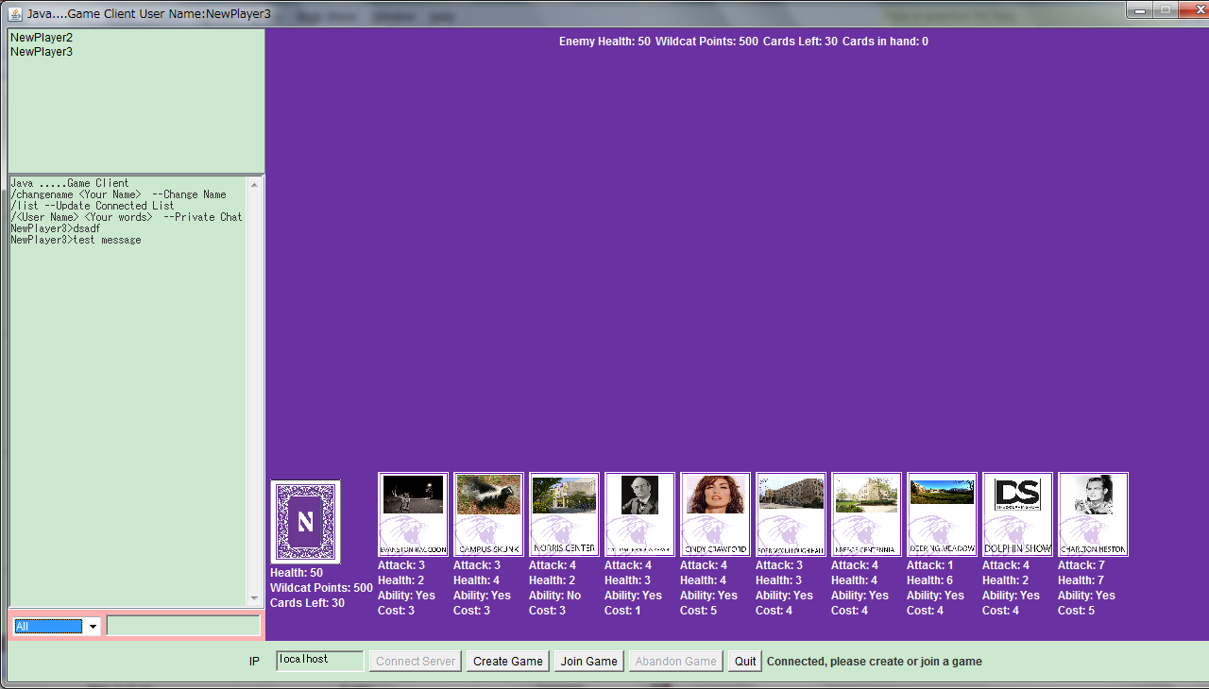
Overview

Slide 4
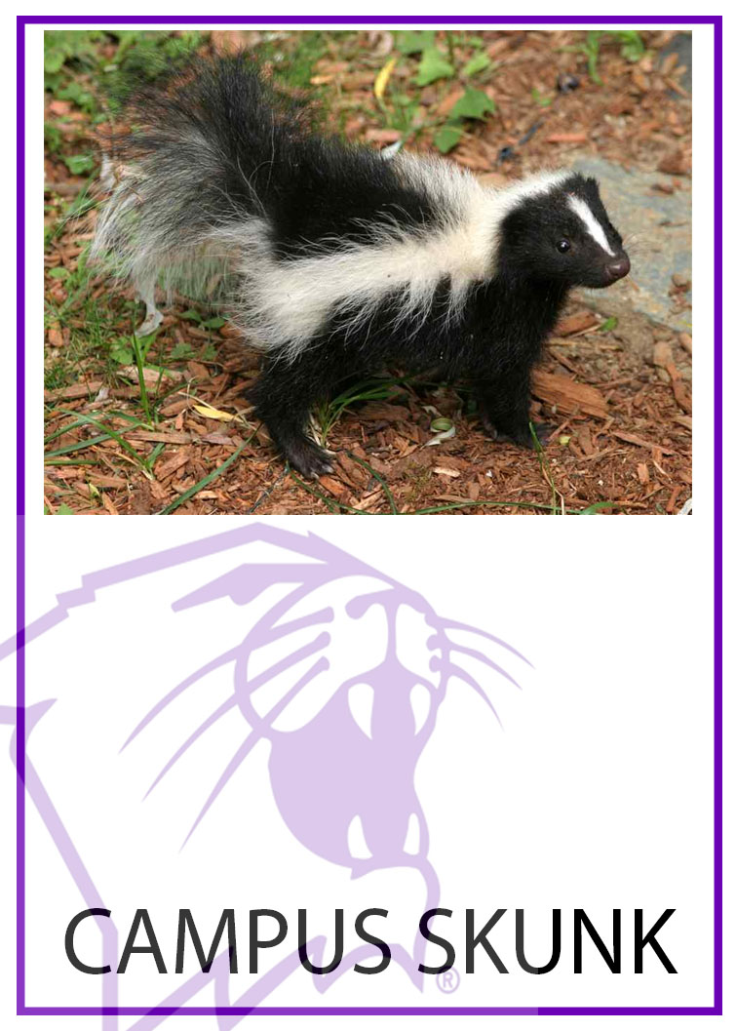

Northwestern-Themed??
A few of our cards…

Slide 5
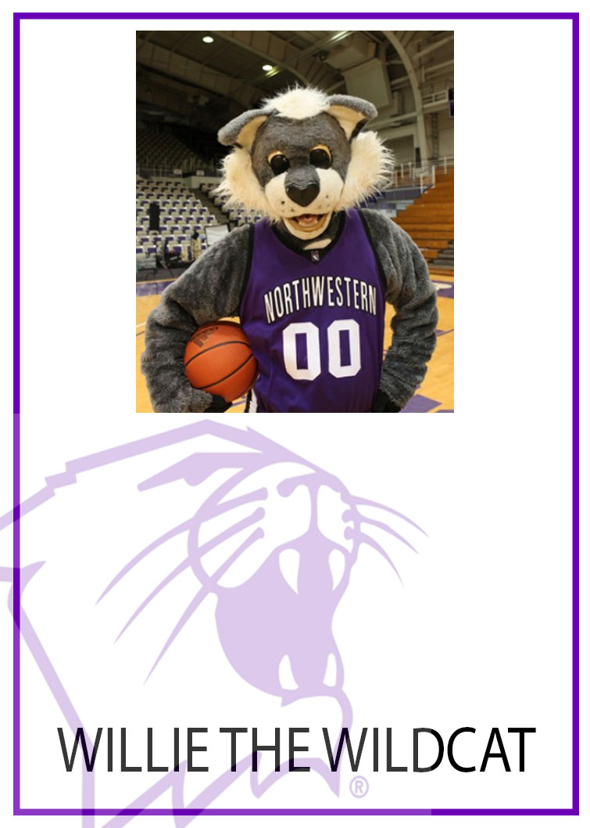
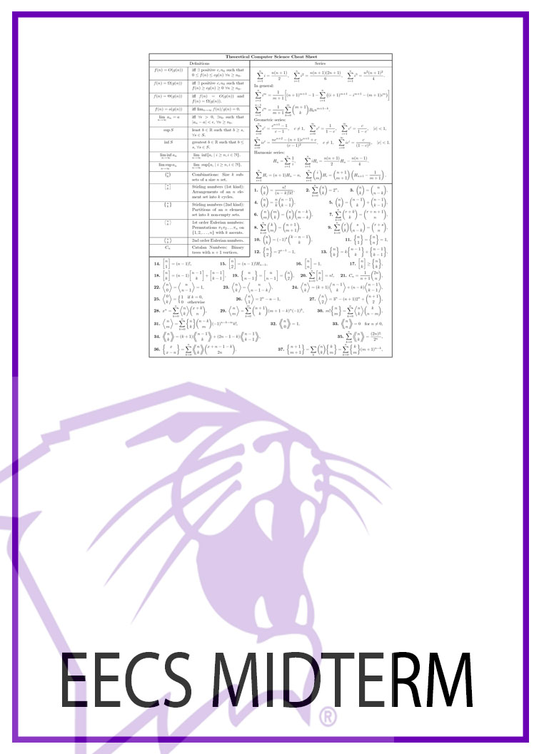
Cards cont.

Slide 6

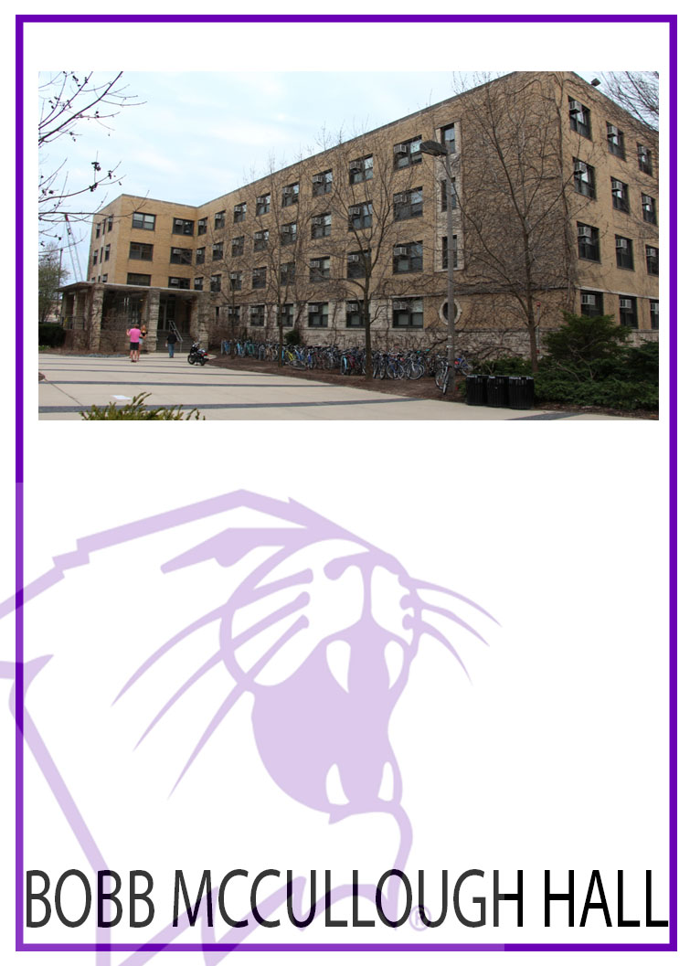
Cards cont.

Slide 7

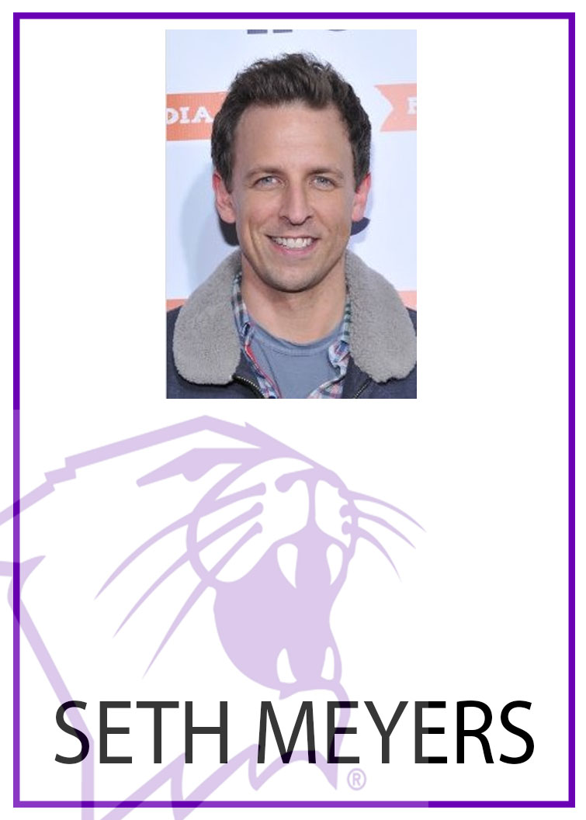
Cards cont.

Slide 8
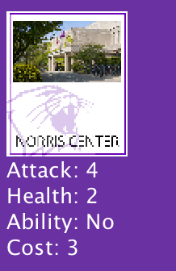
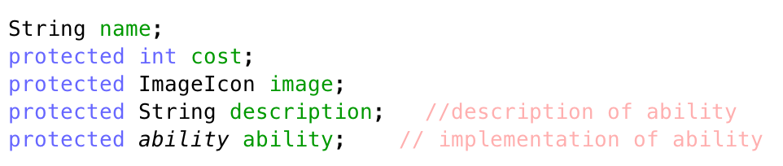
What is a Card?
Cost
Health
Attack
Ability
Description
Name

Slide 9
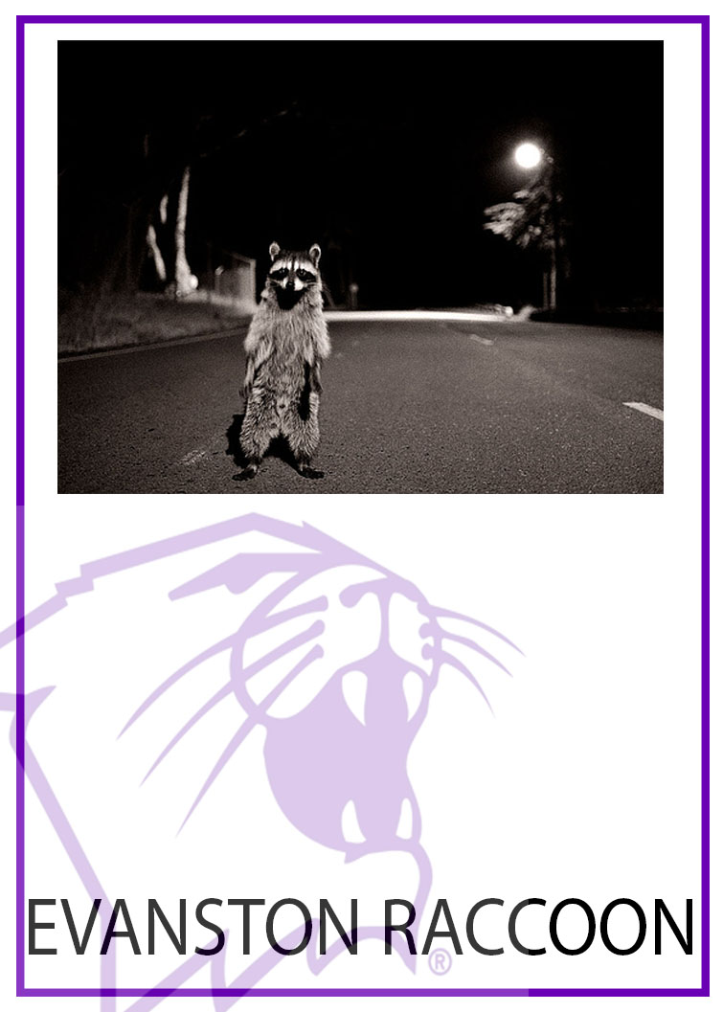
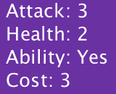
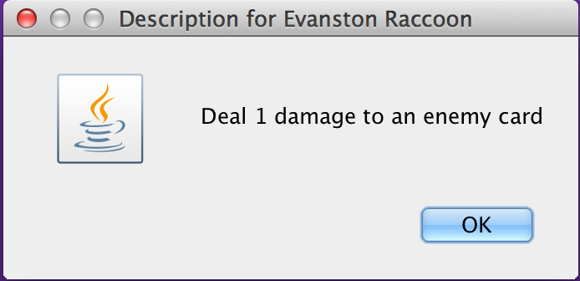
Abilities

Slide 10
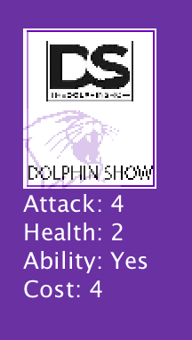
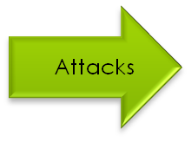
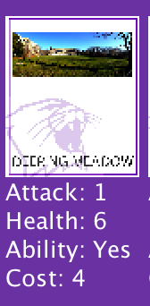
Card Interaction
When a card attacks another card, health values are exchanged based on attack
RESULT
DS
Attack: 4
Health: 1
DM
Attack: 1
Health: 2

Slide 11
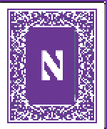
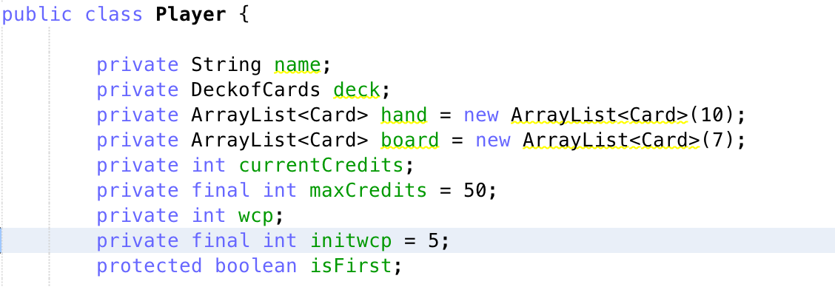
The Player
Total Health (in Credits)
Wildcat Points (resource)

Slide 12
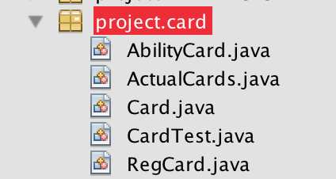
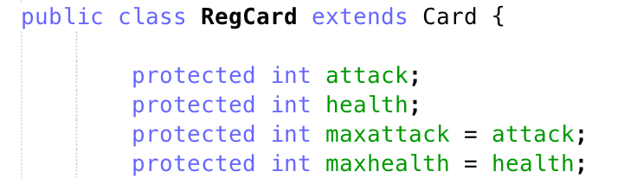
Card Hierarchy

Slide 13
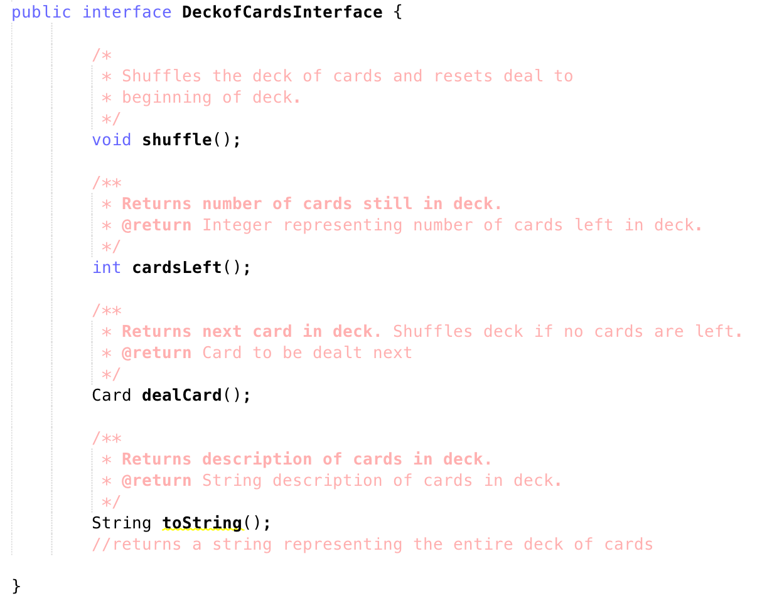
Deck

Slide 14
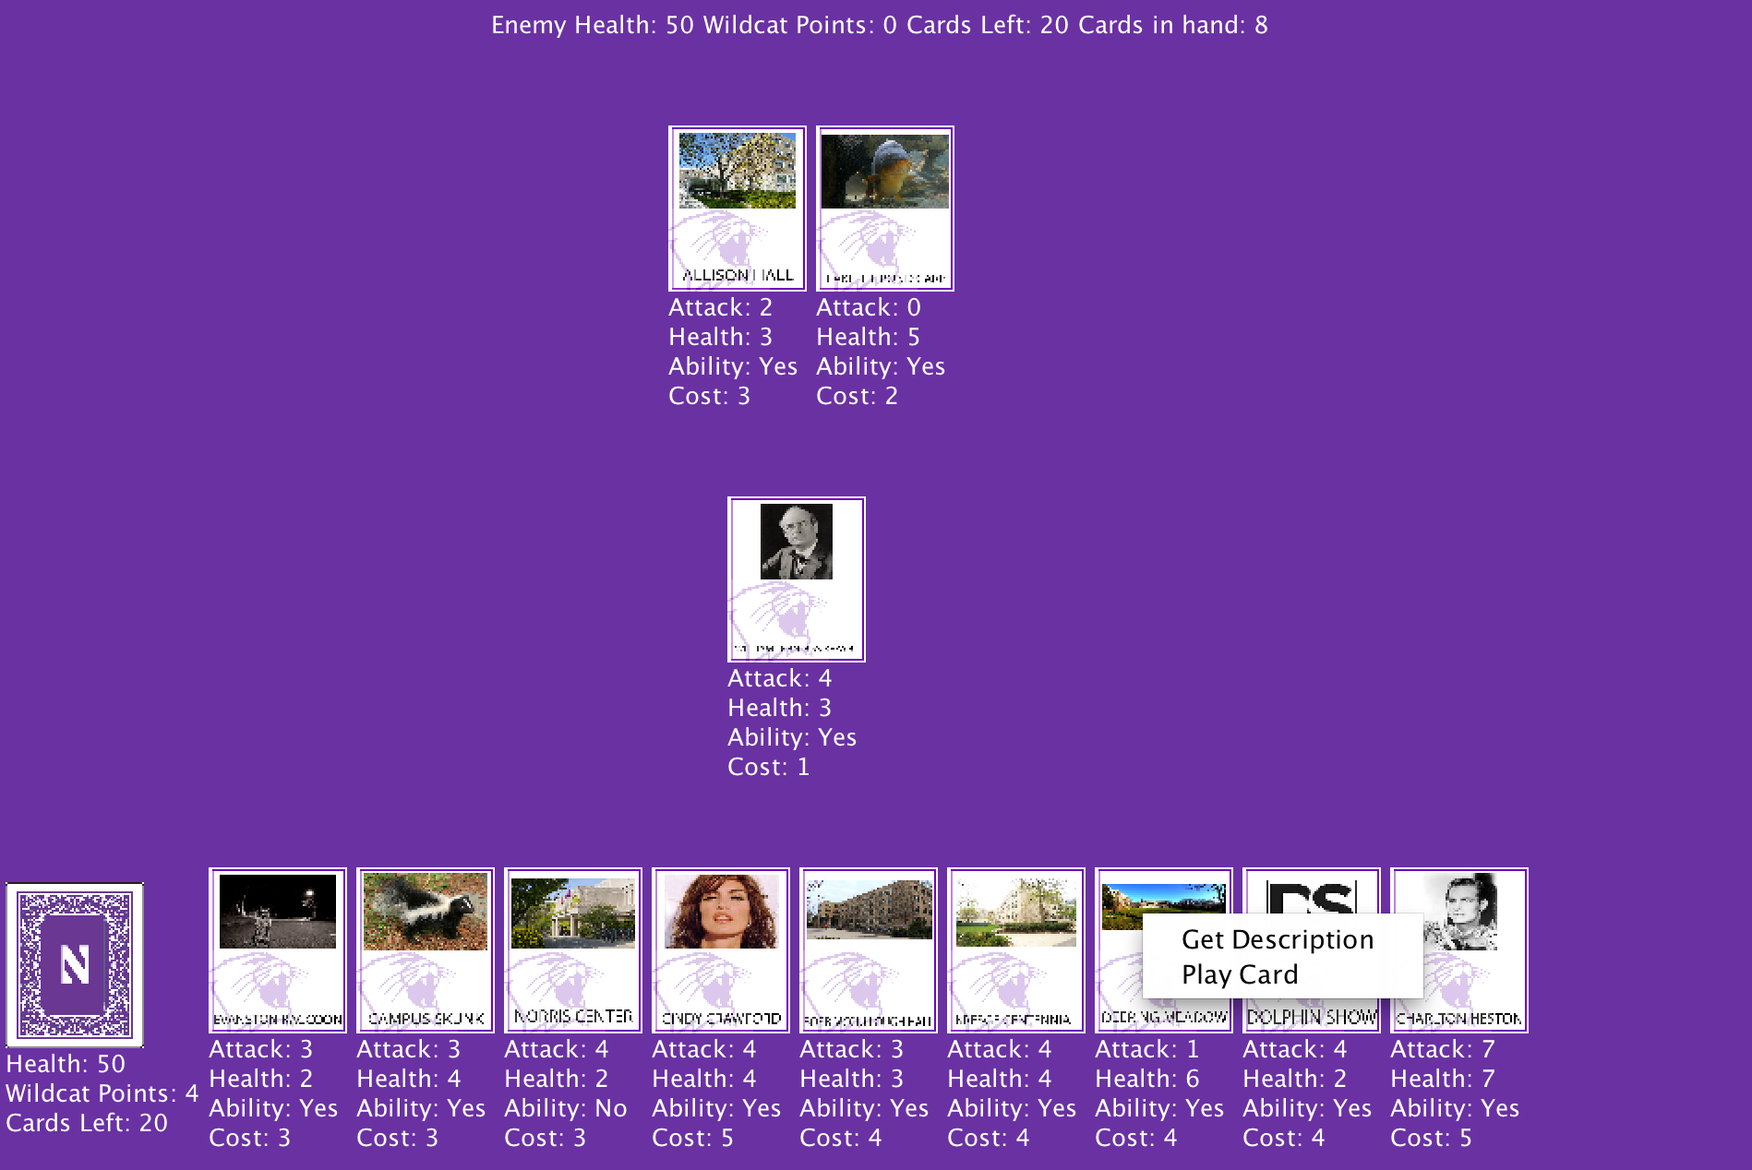
Game Board

Slide 15
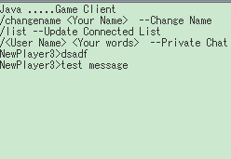

Chat Interface
Send chat messages to all/one players
Show game message

Slide 16
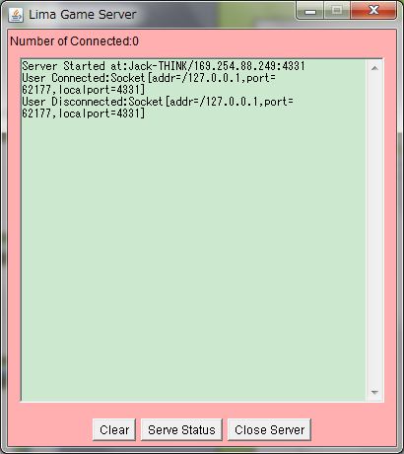
Lima Server
Relay messages
between two players

